Slide 1

OGC API – Tiles Sprint
Sponsored by
Day 1
23rd April 2020

Slide 2
Welcome
What is an OGC Sprint?
A collaborative and inclusive event driven by innovative and rapid programming with minimum process and organization constraints to support the development of new applications and open standards.
Objectives of the OGC API – Tiles Sprint
Develop implementations of OGC API – Tiles
Test implementations of OGC API – Tiles (including those from VTP2)
Provide feedback on the specification

Slide 3
Housekeeping
Keep your camera off at all times.
Only switch your microphone on when speaking.
Follow the chair/facilitator’s guidance.
Say your name before speaking...
“Hi, this is Gobe…”

Slide 4
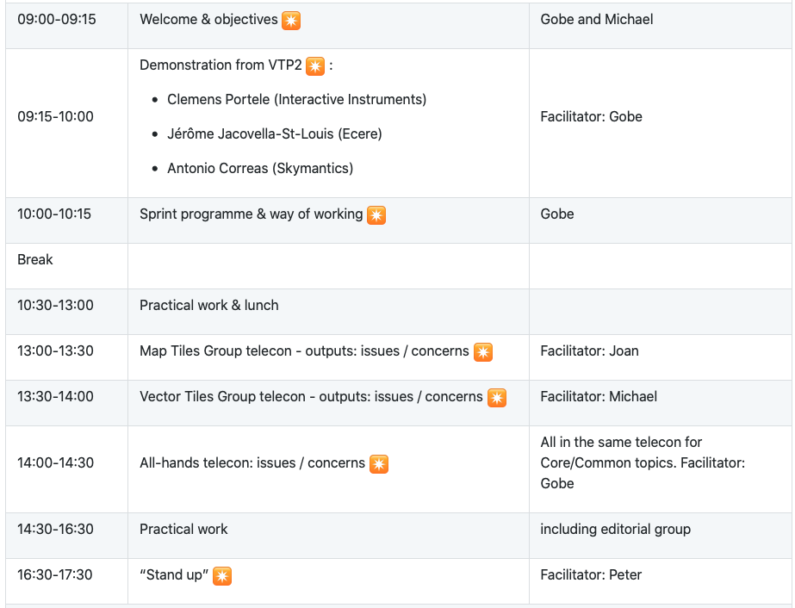
Schedule – Day 1

Slide 5
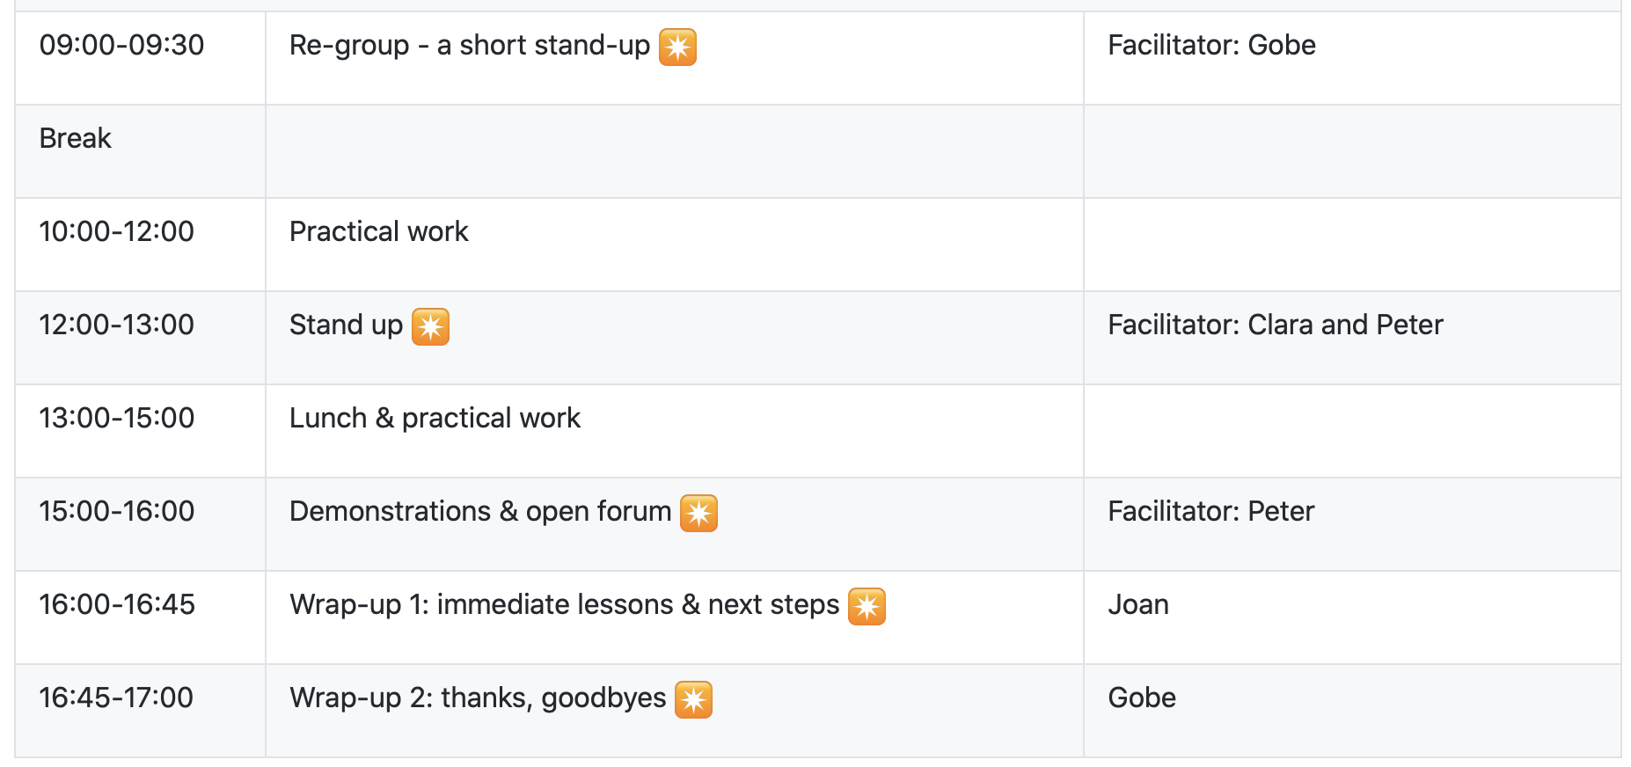
Schedule – Day 2

Slide 6
Sponsor’s Welcome Remarks

Slide 7
Ways of Working
Participants are welcome to bring partial or complete implementations of servers or clients to support the sprint.
Participants will have the opportunity to experiment with parts of the specification and develop working services.
This development can either be done with:
source data that participants bring to the event themselves, or
source data made available by Ordnance Survey, such as OS Open ZoomStack.

Slide 8
Sprint Cycle
Discuss in Telecon
Implement
Discuss on Gitter
Show & Tell

Slide 9

Logistics
Gotomeeting
Link to be provided to registered participants only.
Gitter
https://gitter.im/opengeospatial/OGC-OS-Sprint-04-2020
GitHub
Public repo https://github.com/opengeospatial/OGC-OS-Sprint-04-2020
OGC API – Tiles issues https://github.com/opengeospatial/OGC-API-Tiles/issues
Other Sprint issues https://github.com/opengeospatial/OGC-OS-Sprint-04-2020/issues

Slide 10
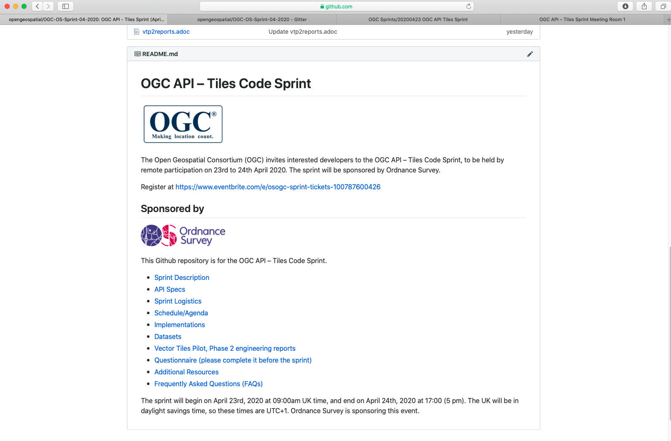
What’s on the Github Repo?

Slide 11
Schedule – Day 1

Slide 12
Schedule – Day 2

